Slide 1

SURVIVING THE RECOVERY
The Distribution of Canadian Household Debt
Armine Yalnizyan
Senior Economist Canadian Centre for Policy Alternatives
Annual CEA Meetings
Ottawa
June 3, 2011

Slide 2
Household debt stabilizing…..at record highs. Is this a debt wall?
Notes:
Source: Statistics Canada, National Balance Sheets - 1806, Table 378-0012 - Financial indicators, persons and unincorporated businesses, quarterly (percent)
Really the non-corporate, non-government, non-foreign sector.
NFPs in the mix in SNA, the “community”, para-government; it’s big, about 10% of GDP. [fact check from SPT report]
Really struggling in this environment, going in the red. Going from projectt o project, no core, already v. lean, reserves dried up, have to borrow to keep going, hard to make up revenues.

Slide 3
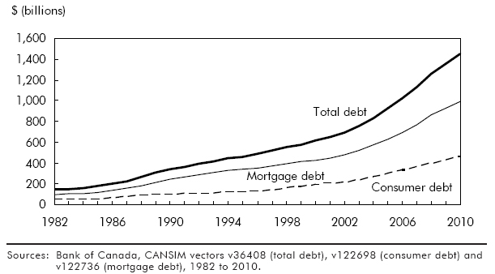
Two Drivers of Debt
Notes:
Chart is from StatCan april 2011 article http://www.statcan.gc.ca/pub/75-001-x/2011002/article/11429-eng.htm
Mortgage debt about 68% of total debt, pretty consistently. A little higher in the early 1990s. Between 2009 and 2010, consumer debt rose a little more rapidly, but mortgage debt also expanding – low interest rates, more first time buyers.
Conflicting stories re retrenchment versus expansion.
On average we owe $26,000 outside of mortgages, Dana Flavelle, Toronto Star, June 1 2011 story. Increase of $1K (4.5%) over last year
Mortgage lending slowing
Delinquencies on cards rising (CBA says falling to Oct 2010, but maybe more recent info cited in piece?)

Slide 4
How risky is this?
Aggregates don’t tell the full story
Distributional element is key – incidence of the problem, depth of problem, “hot spots”
Debt rising among all income groups according to SFS data, 1999 to 2005
Notes:
The first Canadian Financial Capability Survey (CFCS) was conducted between February and May 2009. There were 15,519 respondents.

Slide 5
Trend to higher indebtedness by 2005
Notes:
Exception of Q1, picking up more paid work in the wake of the recession, higher income, so lower debt “burden”
But everyone living large, larger than the growth in their incomes, despite this being a boom time for economic growth.
Fastest growing growth- in -debt for those over 65.

Slide 6
And here’s why – it seemed affordable
Notes:
The beginning of the asset bubble. Can’t feel a thing! Too bad for the folks in Q1: SFS shows they lost ground in the asset department (particularly D1) – their debt load is going up!

Slide 7
Oh, and here’s another reason why – no real income growth for most til 2007
Notes:
No appreciable increase in after tax incomes for bottom half of the distribution from 1976 until 2007 (two bump downs, 1981-2 recession, 1990-1 recession, playing catch-up til 2007). Just nosed past old high water mark. Then recession. Again. First real post-recession data out out later this month.

Slide 8
What’s happened since 2005?
Lack of data on distribution of debt and assets since SFS 2005. (How about that recession?)
CFCS 2009 provides a glimpse, no before and after the recession
Sample size – just over 15,500
Complaint about constraints on StatCan

Slide 9
Canada: Not just the Land of Debt
Notes:
66.5% of those who answered debt question had debt
19.8% did not answer the debt questions (40.5% of 18-24 year olds)
Survey might underestimate the problem.
Another report from April 2011 shows 72% (or close).
Quintile levels in this sample are on high side. So sample base may be skewed to the high side (v. likely, more likely than the opposite)

Slide 10
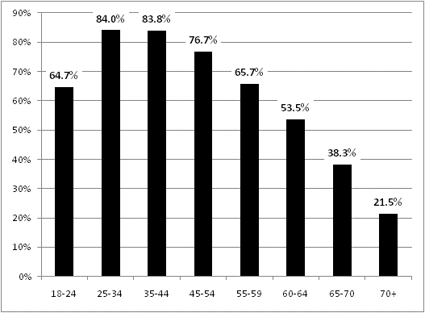
Incidence of Debt in 2009 – By Age
Notes:
CFCS 2009
Lifecycle issues, but important to see what %. Vast majority of people under 45 and over 25. Big numbers, right up to retirement. Surprisingly high 70+

Slide 11
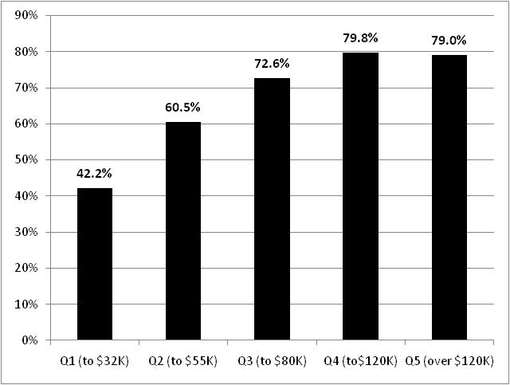
Incidence of debt in 2009 – by quintile
Notes:
Household quintile. [Quintiles values high. SLID in 2008 was $25 to top of decile 2, pre tax; the top 80% began at $104 ]
Again not the amount of debt, but the incidence. Majority of lowest income not debtors (because majority are seniors? Read on)

Slide 12
How Deep Is the Hole?
Only one in five households with debt (21%) owe MORE THAN $200K
  highest incidence in Q 4 and Q5
  age sensitive (highest incidence among under 45s)
Half of households with debt (49%) owe LESS THAN $50K
  highest incidence in Q1 to Q3
  less age-sensitive
Notes:
Hope to have custom tabulations by the summer on actual debt levels – not just groupings. Still problem is nothing to compare with. One observation. No before and after.

Slide 13
Distribution of Debt over $200K, 2009 by age and quintile
Notes:
Mostly younger; highest incidence in Q4 and Q5
(mostly mortgage?)
Almost no difference between Q1 and Q2 (debt levels over $200K can be very different though!) Q3 also clustered at higher age levels.
Surprisingly high incidence for elderly (60+), particularly in Q5.

Slide 14
Distribution of Debt Under $50K, 2009 by age and income quintile
Notes:
Almost no age-sensitivity within quintiles. Again, unexpectedly high among elderly.
(Reasons: front end of baby boomers not saving enough? Lost jobs during recession and couldn’t find another.? Living off reverse mortgages? )
Very high incidence in Q1, right up to 70+, NOTE high incidence in Q2 and Q5 for elderly (65+)
Debt normal (sometimes a problem) early in life, but can be a problem surprisingly late in life.

Slide 15
Who’s most exposed to risk?
Lower income: more potential for small things to become financial catastrophes
Big debt: very reliant on job, income security
Elderly lower incidence, but not risk-free
Response to recession – are we deleveraging yet? Household financial flows critical
Notes:
Temptation to think debt is an age thing – you’ll grow out of it; or an issue of choice – higher income households want bigger “better” houses, cars, vacations.
But as macroeconomic forces change, another downturn, higher interest rates, industrial restructuring, you have a massive problem of devaluation of assets, income loss and bankruptcy. The more broadspread the problem, the bigger the ripple effect
That’s why its important for some people, somewhere, to reign in their spending, get things back under control vis a vis incomes.
And important that incomes don’t keep getting cut!

Slide 16
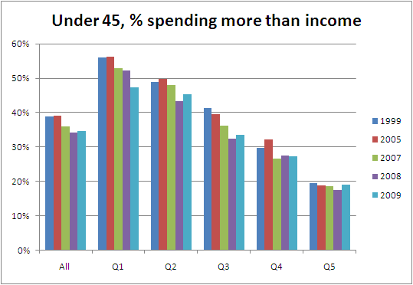
Under 45s hardest hit since recession
Notes:
Source: Survey of Household Spending custom tabs. Sample size 16,700 in 2009
Overall: Long term story improving, but recessionary set back for some (surprisingly mild, could have something with self-reported status)
SHS says 2009 average spending declined 0.3%, first time declined since survey introduced in 1997. http://www.statcan.gc.ca/daily-quotidien/101217/dq101217a-eng.htm
Since recession, increase in proportion of those spending more than income …..except for Q1, large show of constraint, belt-tightening (because it won’t be due to improved incomes in 2009)

Slide 17
Living within their means? Mixed story for 45-64 year olds
Notes:
Same income determines spending power story,.
Troubling that close to half of those in Q1 at prime living close to edge; improvement for Q2 and Q3 in wake of recession (milder for Q3), Q4 not much change over the decade
Perhaps Q1 and Q5 represents those with most job and income/bonus loss in 2009
More flexible in adjusting spending.
Likely group that has seen the biggest income increases (managers from this age/income group)

Slide 18
More people draining savings, borrowing among elderly
Notes:
Likely dipping into savings rather than borrowing.
Data problems, again – can’t separate “Spenders” into “debt” versus “running down own financial cushion”.
That’s why turned to CFCS, but only one data point in time.

Slide 19
Caution: Bumpy Road Ahead
Rising prices
Downward pressure on wages, benefits, pensions (for some, not all)
Government cutbacks (fewer good paying jobs)
Slow private sector job creation (and more temporary jobs)
Rising interest rates
Slowth (slow growth) in many places
Notes:
CEO income report released on Monday 13% increase for top 100 CEOs, median pension adjustment for these 100 people $9 mllion….DEFINED BENEFIT plans. That’s one of the big things the bosses want the workers to expect less of: defined benefits, smaller legacy costs.
Re cuts federal level alone promises 80,000 fewer people. Manufacturing and public sector used to be backbone of middle class, together formed almost half the jobs is generation ago, now about 30%.
Private sector creating mostly temporary, contract jobs. Fewer benefits. Two tiering other permanent jobs re wages, benefits, pensions.
So where will the next middle class come from?
East-west dynamic? Also north –south dynamic pitting growth zones of the economy against no growth zones.

Slide 20

Good Luck With That Austerity Plan

